Slide 1
Social Studies Study Tips

Slide 2
Vocabulary Practice:
Flash Cards: Make flash cards out of the important terms and names from the unit. Use these cards to review with a partner while you prepare for the upcoming assessment.
Hint: Make flash cards while you do homework (why make the same thing twice)
Know how to pronounce the name or term: Often the names of people or the terms we are discussing are new to you. Many have similarities in how they are spelled. If you know how to pronounce the term then you are more likely to remember it on a quiz or test.
Hint: Use the phonetic spelling in the text or ask me!
Hint: Always practice it correctly or you will not properly remember.

Slide 3
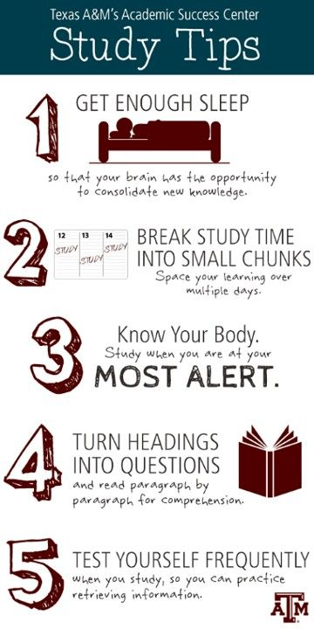
Study Guides:
Always complete as much of the study guide as possible without looking up the answers right away. Highlight the questions you needed to look up because those are topics you are likely not as prepared for.
Always check your work and add any ideas to your study guides when we review them together in class.
Meet with me at resource to review the study guide together and discuss possible points of emphasis.
Hint: I am your greatest source for questions about the upcoming assessment. Take advantage of using me at resource or after school to review.

Slide 4
Reading Assignments:
When you finish a section in a reading assignment identify in one sentence the main idea of what you just read.
Hint: Use the Three Main Ideas activity you were given in the study session. Check in with me at resource to review the main ideas to be sure you are getting the reading assignment.
Always read the entire assignment (or at least the entire section) before you begin responding to questions or defining terms. When finished reading go back to do the written work.
Hint: This will help you better understand what you have read because you will have read it uninterrupted.

